Slide 1











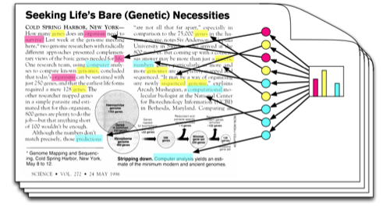
Classification and Analysis of Public Comments to Rulemaking
Arthur Pignotti
Health Insurance Specialist
CMS
Background on Comment
Review Process
Stakeholders: Staff, SMEs, Leadership
Step 1: Post Proposed Rule
Step 2: Receive Public Comments
Step 3: Sort & Review Comments
Step 4: Brief Leadership & Get Decisions
Step 5: Write & Publish Final Rule
Review and sort >1,000 pages of comment for each proposed rule
Brief leadership quickly and maintain tight deadlines
Provide in-depth analysis while writing final rule
Customer Need
Train topic model, using proposed rule
Use programming to convert public comments
Use topic model to classify comments by proposed rule section
Solution & Approach
Benefits
Can save >100 hours per rule
Quicker & better decisions
More time for writing
Ability to do better analysis
Alternatives
CAAT on FDMS
SAS Text Miner
SAS Contextual Analysis
Manual Review

